Slide 1
MDX: Multi-Dimensional Expressions The query language for Cubes
Kurt Friedrich
Spring 2015

Slide 2
MDX
More like PIG than SQL?
Excellent article: https://www.codeproject.com/articles/710387/learn-to-write-custom-mdx-query-first-time
https://msdn.microsoft.com/en-us/library/ms144785.aspx
http://www.iccube.com/support/documentation/mdx_tutorial/gentle_introduction.php

Slide 3
SQL? MDX?
SQL was designed to query dimensional data structures, called tables, where data are organized in rows and columns.
In OLAP, data are organized around multiple measures, dimensions, hierarchies, and levels.
MDX is a language used to perform calculations and analysis around OLAP structures.
MDX includes a rich set of functions for performing statistical analysis.
Unlike SQL, MDX does not have DDL (Data Definition) or DML (Data Manipulation) capabilities.
MDX is purely for analyzing and reading data.

Slide 4
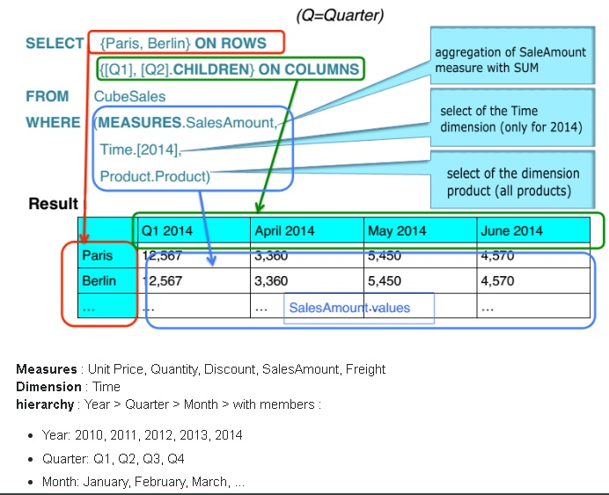
Structure of MDX query

Slide 5
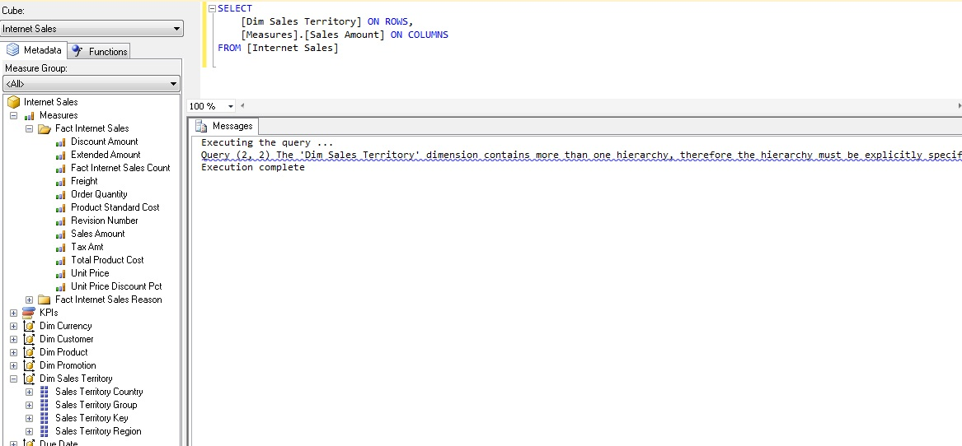
Notice we have a collection of Measures, and another of Dim(ensions)

Slide 6
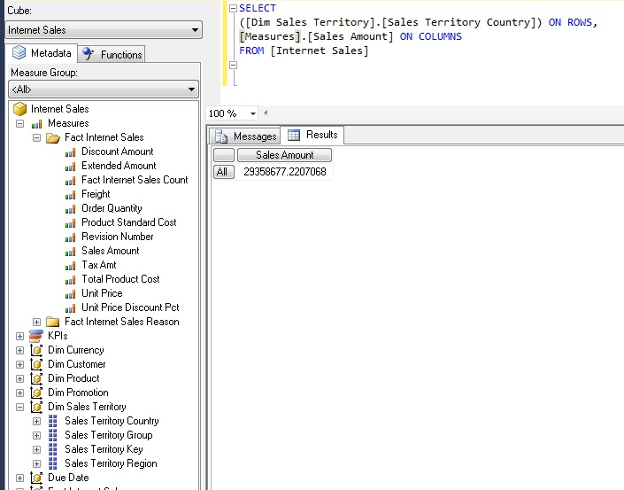

Slide 7
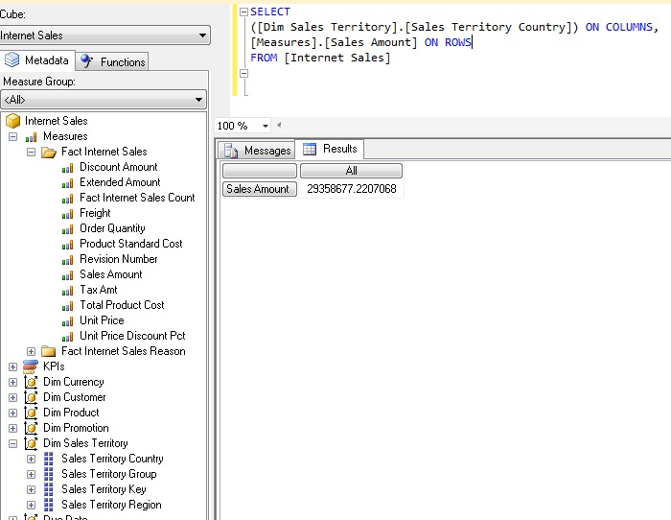
Flip ROWS and COLUMNS … and they can appear in either order

Slide 8
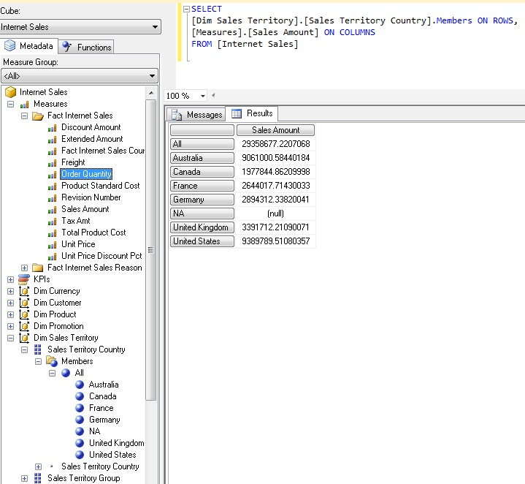

Slide 9
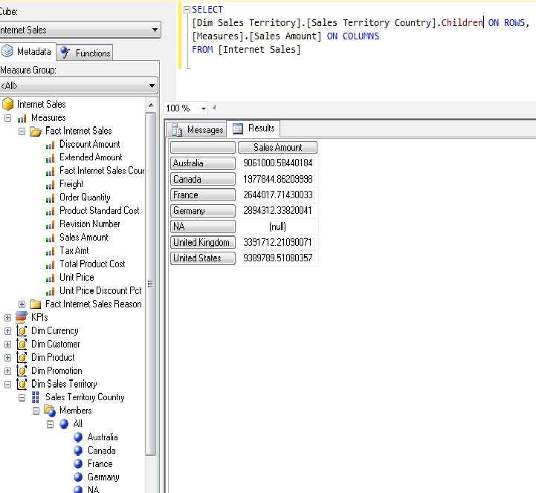
The Children function returns a naturally ordered set that contains the children of a specified member. If the specified member has no children, this function returns an empty set.

Slide 10
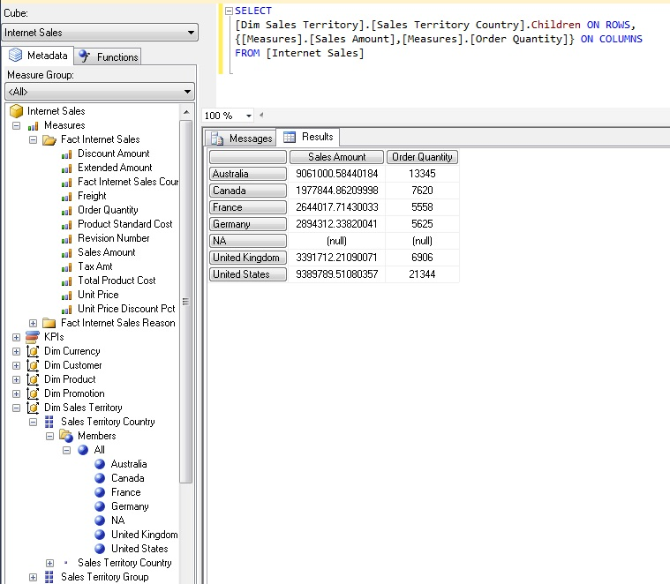
SELECT
([Dim Sales Territory].[Sales Territory Country].Children) ON ROWS,
{[Measures].[Sales Amount], [Measures].[Order Quantity]} ON COLUMNS
FROM [Internet Sales]
Tuples again?

Slide 11
WHERE clause
Unlike the WHERE clause in SQL, the WHERE clause of an MDX SELECT statement never directly filters what is returned on the Rows axis of a query.
To filter what appears on the Rows or Columns axis of a query, you can use a variety of MDX functions, for example FILTER, NONEMPTY and TOPCOUNT.

Slide 12
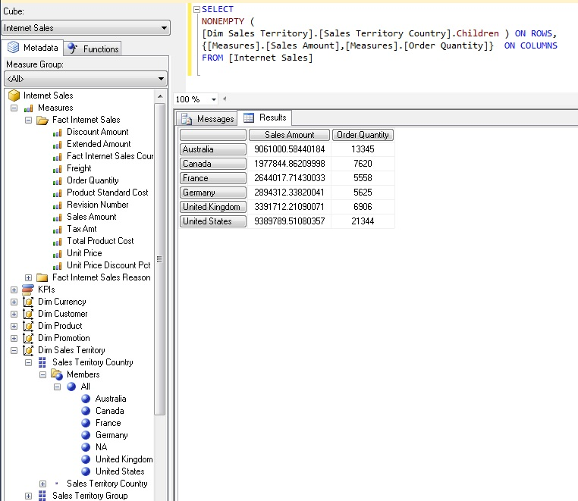

Slide 13
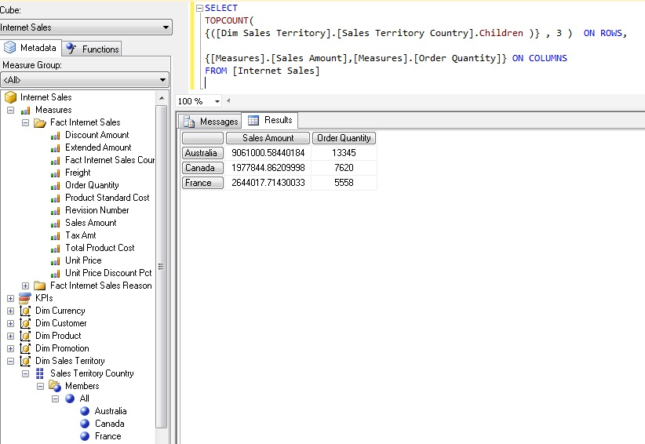

Slide 14
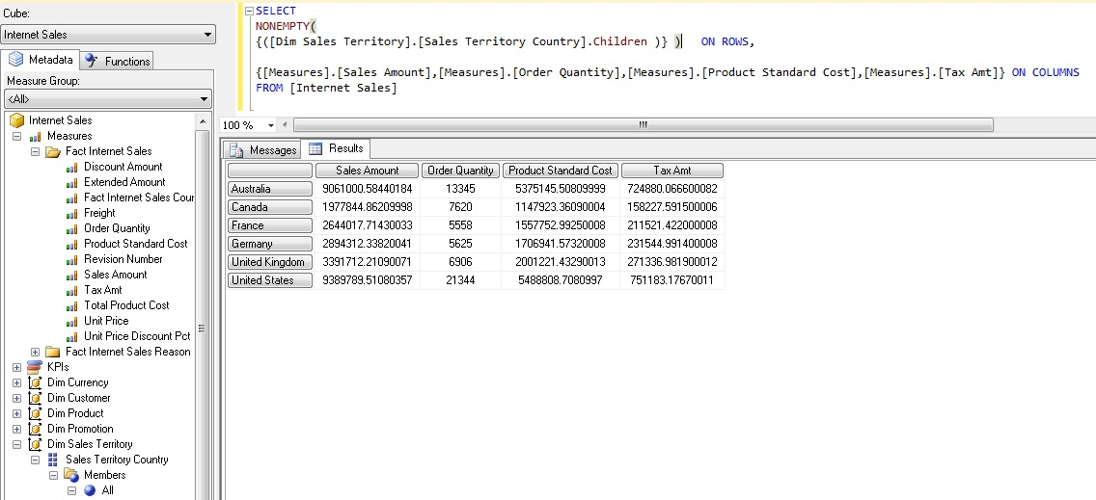

Slide 15
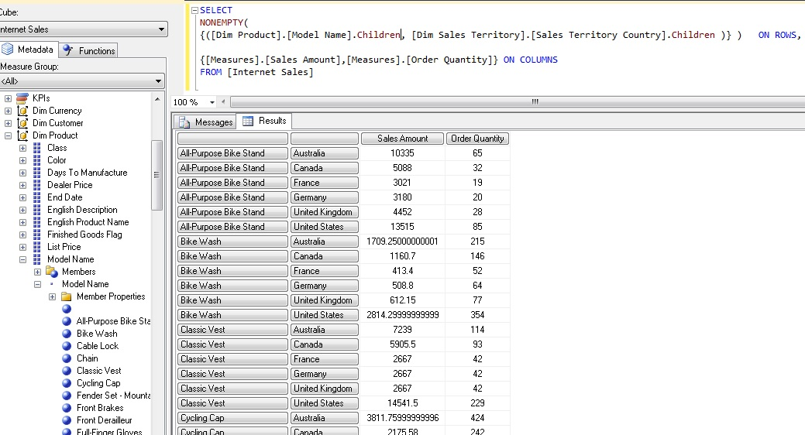

Slide 16
As you specify measures or dimension attributes, you can place them on the row or column areas.
If you don’t extend the name, you get the .All value by default. So .Children or something usually makes more sense.
Think of tuples like an intersection on an (x,y) map from algebra. It’s the intersection of two variables. Tuples here are a cross section or intersection of two areas in your cube.
If you have multiple tuples, they are called sets.

Slide 17
To point to a set (x,y) coordinates in a tuple, wrap the cross join in parentheses and separate with a comma.
SELECT
NON EMPTY
([Dim Product].[English Product Name].Children, [Measures].[Sales Amount]) ON COLUMNS ,
NON EMPTY [Due Date].[Calendar Year].Children ON ROWS
FROM [Adventure Works DW Cube]

Slide 18
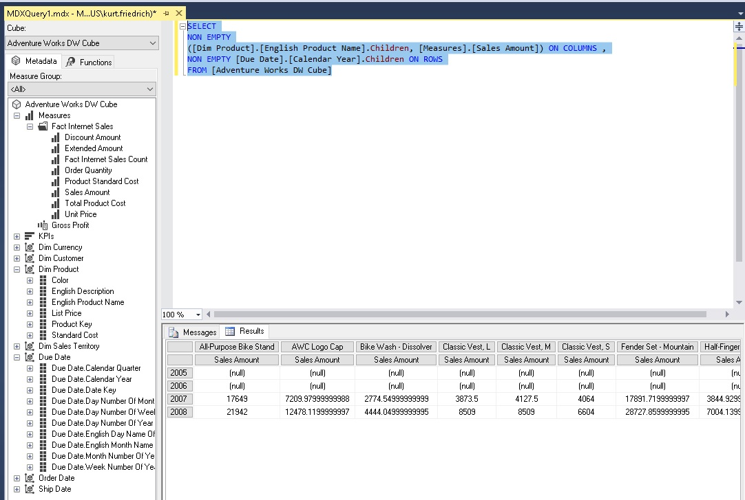

Slide 19
You can have multiple attributes and measures along either axis
SELECT
NON EMPTY
( [Product].[Category Name].Children ,
[Product].[Subcategory Name].Children,
[Measures].[Sales Amount]
) ON COLUMNS,
NON EMPTY
( [Due Date].[Year].Children,
[Due Date].[Quarter].Children
) ON ROWS
FROM [AWDW2012R2Cube]
(I don’t think you can have measures on both row and column, just one or the other)

Slide 20
If the data was in a SQL Relational DB
-- need distinct count, we're counting orders, not order lines
SELECT count(DISTINCT soh.salesorderid) ,pers.FirstName + ' ' + pers.LastName
FROM sales.SalesOrderDetail sod
-- we need product details to get to the category
INNER JOIN Production.Product p ON sod.ProductID = p.ProductID
-- but we need to pass via subcategories
INNER JOIN Production.ProductSubcategory psc ON p.ProductSubcategoryID = psc.ProductSubcategoryID
-- we finally get to the category
INNER JOIN Production.ProductCategory pc ON psc.ProductCategoryID = pc.ProductCategoryID
-- we also need the headers because that's where the customer is stored
INNER JOIN sales.SalesOrderHeader soh ON sod.SalesOrderID = soh.SalesOrderID
-- finally the customer, but we don't have his name here
INNER JOIN sales.Customer c ON soh.CustomerID = c.CustomerID
-- customers
INNER JOIN Person.Person pers ON c.PersonID = pers.BusinessEntityID
-- filter on bikes
WHERE pc.Name = 'bikes'
-- but the customers table doesn't contain the concatenated name
GROUP BY pers.FirstName + ' ' + pers.LastName;
If the data was in a BI Cube DB
SELECT [Measures].[Internet Order Count] ON COLUMNS,
[Customer].[Customer].Members ON ROWS
FROM [Adventure Works]
WHERE [Product].[Product Categories].[Category].[Bikes]

Slide 21
Some adventureworks queries
With Use { , } to show more than 1 Measure item
queryString = " SELECT {[Measures].[Sales Amount], [Measures].[Order Quantity]} ON COLUMNS, " +
" Non Empty { [Dim Sales Territory].[Sales Territory Country].Children} ON ROWS " +
" FROM [InternetSalesCube] ";
With a calculation using 2 dimensions
queryString = " WITH MEMBER [Measures].[Profit] AS '[Measures].[Sales Amount] - [Measures].[Product Standard Cost]' " +
" SELECT [Profit] ON COLUMNS, " +
" Non Empty { [Dim Sales Territory].[Sales Territory Country].Children} ON ROWS " +
" FROM[InternetSalesCube]";
With a calculation using 2 dimensions by 2 Measures
queryString = " SELECT NON EMPTY { [Measures].[Sales Amount], [Measures].[Order Quantity] } ON COLUMNS, " +
" NON EMPTY { ([Dim Sales Territory].[Sales Territory Country].[Sales Territory Country].ALLMEMBERS , " +
" [Dim Product].[Product Line].[Product Line].ALLMEMBERS ) } ON ROWS " +
" FROM [InternetSalesCube] ";
queryString = " SELECT NON EMPTY { [Measures].[Sales Amount], [Measures].[Order Quantity] } ON COLUMNS, " +
" NON EMPTY { ([Dim Sales Territory].[Sales Territory Country].[Sales Territory Country].ALLMEMBERS * " +
" [Dim Product].[Product Line].[Product Line].ALLMEMBERS ) } ON ROWS " +
" FROM [InternetSalesCube] ";
Same
Results?

Slide 22
Ordering Results
First we define what is being sorted (Sales Territory Country);
next how the sort should evaluated (by Sales Amount) ,
and what order should be used (Descending)
queryString = " SELECT ORDER ( [Dim Sales Territory].[Sales Territory Country].CHILDREN, [Measures].[Sales Amount], DESC ) ON ROWS, " +
" Non Empty { [Measures].[Sales Amount]} ON COLUMNS " +
" FROM [InternetSalesCube] ";
queryString = " SELECT Non Empty ( [Dim Customer].[Marital Status].CHILDREN, " +
" ORDER ([Dim Sales Territory].[Sales Territory Country].CHILDREN, [Measures].[Sales Amount], DESC ) ) " +
"ON ROWS, " +
" Non Empty { [Measures].[Sales Amount]} ON COLUMNS " +
" FROM [InternetSalesCube] ";

Slide 23
Showing a subset of one dimension by defining a new dimension
queryString = " WITH SET [EUROPE] AS '{ " +
" [Sales Territory Country].[Sales Territory Country].FRANCE, " +
" [Sales Territory Country].[Sales Territory Country].GERMANY, " +
" [Sales Territory Country].[Sales Territory Country].[United Kingdom] }' " +
" SELECT [Measures].[Sales Amount] ON COLUMNS, " +
" [EUROPE] ON ROWS " +
" FROM[InternetSalesCube]";
Using TopCount (which, count, based on what)
queryString = " SELECT Non Empty [Dim Sales Territory].[Sales Territory Country].GERMANY ON ROWS, " +
" Non Empty TOPCOUNT ( [Dim Product].[English Product Name].[English Product Name].ALLMEMBERS, 5, [Measures].[Sales Amount]) ON COLUMNS " +
" FROM [InternetSalesCube] ";

Slide 24
Using a WHERE clause to get a subset (aka. slicer).
The MDX where clause even though sharing the same name as the SQL statement is fundamentally different.
A MDX WHERE clause reduces the scope of the query.
The WHERE clause reduces the cube into a new 'sliced' cube, the slice being defined by the WHERE clause.
queryString = " SELECT [Measures].[Order Quantity] ON COLUMNS, " +
" NON EMPTY ([Dim Product].[English Description].[English Description].ALLMEMBERS ) ON ROWS " +
" FROM ( SELECT ( [Dim Product].[Color].&[Blue] ) ON COLUMNS " +
" FROM [InternetSalesCube]) WHERE ( [Dim Product].[Color].&[Blue] ) ";
queryString = " SELECT [Measures].[Order Quantity] ON COLUMNS, " +
" NON EMPTY ([Dim Product].[English Description].[English Description].ALLMEMBERS ) ON ROWS " +
" FROM ( SELECT ( [Dim Product].[Color].&[Blue] ) ON COLUMNS " +
" FROM [InternetSalesCube]) "; //) WHERE ( [Dim Product].[Color].&[Blue] ) ";
Using a WHERE clause to get a more complicated subset (red or blue, from U.S.)
queryString = " SELECT [Measures].[Order Quantity] ON COLUMNS, " +
" { [Dim Product].[English Description].[English Description].ALLMEMBERS } ON ROWS " +
" FROM ( SELECT ( { [Dim Sales Territory].[Sales Territory Country].&[United States] } ) ON COLUMNS " +
" FROM (SELECT( { [Dim Product].[Color].&[Red], [Dim Product].[Color].&[Blue] } ) ON COLUMNS " +
" FROM [InternetSalesCube])) " +
" WHERE ([Dim Product].[Color].CurrentMember, [Dim Sales Territory].[Sales Territory Country].&[United States] ) ";
queryString = " With Member [MEASURES].[LOTS] as " +
" IIF( " +
" [Measures].[Sales Amount] > 200000 , " + // condition to check
" [Measures].[Sales Amount], " + // measure to display
" null ) " + // what to display if not true, null leaves them out
" SELECT NON EMPTY [Dim Sales Territory].[Sales Territory Country].CHILDREN ON COLUMNS, " +
" NON EMPTY { [Dim Product].[Model Name].[Model Name] } ON ROWS " +
" FROM [InternetSalesCube] WHERE [MEASURES].[LOTS] ";
Same results?

Slide 25
Get product name only if red or blue
queryString = " SELECT NON EMPTY { [Measures].[Order Quantity] } ON COLUMNS, " +
" NON EMPTY { ([Dim Product].[English Product Name].[English Product Name].ALLMEMBERS ) } ON ROWS " +
" FROM(SELECT( { [Dim Product].[Color].&[Red], [Dim Product].[Color].&[Blue] } ) ON COLUMNS " +
" FROM [InternetSalesCube] ) ";

Slide 26
https://www.iccube.com/support/documentation/mdx_tutorial/gentle_introduction.php
https://msdn.microsoft.com/en-us/library/bb500184.aspx

